Slide 1
CityGML SWG
WP 3 Report
95th OGC Technical Committee
Boulder, Colorado USA
Gerhard Gröger (IGG/SIG 3D)
June 3, 2015

Slide 2
Revision of LoD concept: Overview
Problems with current LoD concept (CityGML 2.0)
New LoD Concept: Principles
UML diagram
Example encodings
Profiles for embedding CityGML 2.0
Mandatory profiles for CityGML 3.0
Status of Work
Answers to Question of SWG Chairs

Slide 3
WO 03: Revision of the LoD concept
Problems with current LoD concept (CityGML 2.0):
  not flexible enough and too restrictive for important use cases, e.g.,
    no coarse representations (LoD 1 or 2) for indoor features (energy applications, facility management)
    no indoor LoDs (indoor navigation)
    no indoor features only, without outer shell (indoor navigation)
    no openings in LoD2 (energy applications)
    no different representations in the same LoD, e.g. two LoD3 architectural designs (planning)

Slide 4
New LoD concept: General Principles I/II
The new LoD concept
is a generic multi-representation framework
  LoD are only one aspect of multiple representation
principally allows any geometric representation for any CityGML object
  e.g., two different LoD1 representations of a building
replaces the CityGML 2.0 LoD concept with specific geometric properties loDxSolid, loDxMultiSurface, …… in specific feature classes
Constraints should exclude unreasonable geometry representations, e.g. a solid representation for a wall surface

Slide 5
New LoD concept: General Principles II/II
Based on the general framework, profiles can be defined
Profiles
  restrict the variability of geometric representations
      e.g., a building is represented as prismatic block by a solid (LoD1)
  support generation and interpretation of CityGML 3.0
  support embedding of the CityGML 2.0 LoD concept
  assign a geometry type and a geometric definition to a feature type
  are uniquely identified by an URI
a number of profiles shall be defined and published in the CityGML specification (official profiles)
Users/Communities may define own profiles

Slide 6
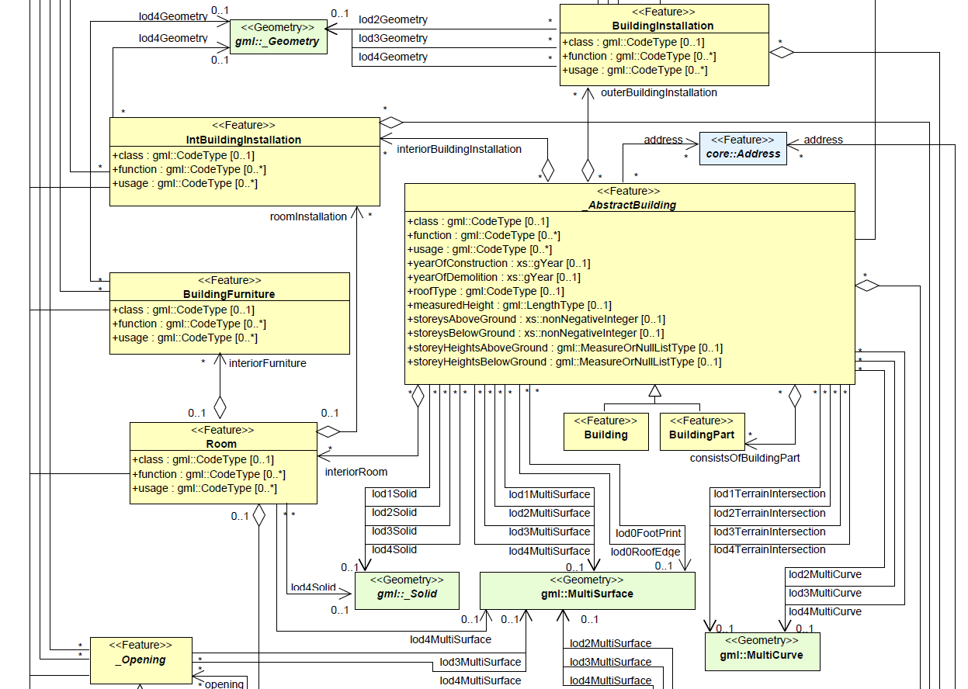
CityGML 2.0 Geometry Properties: Replacements

Slide 7
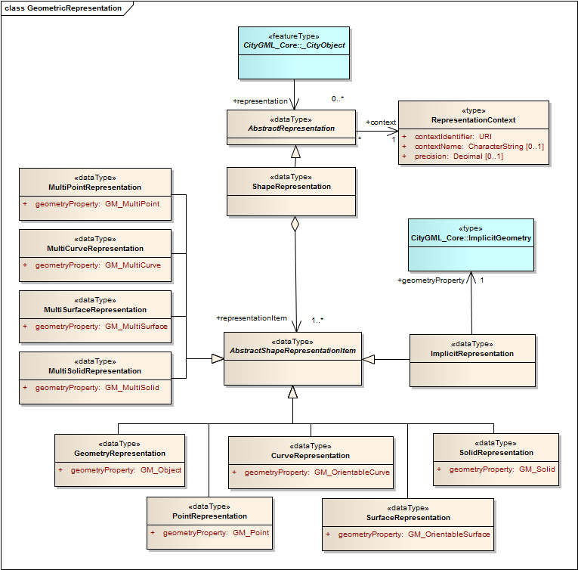
UML Diagram

Slide 8
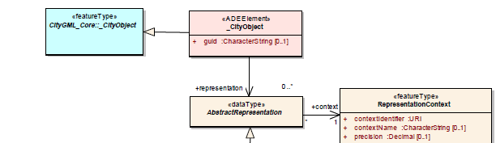
UML Diagram: Principles
Enables separation between concept and encoding
  ISO 19107 (Abstract Geometry) and ISO 19139 (GML) Classes
Relation AbstractRepresentation to RepresentationContext:
  referenced via Xlinks (stereotype <<type>>)
  A Context can be shared between multiple Representations (efficiency)
Can be implemented in CityGML 3.0 (figure on last slide) or as 2.0 ADE:

Slide 9
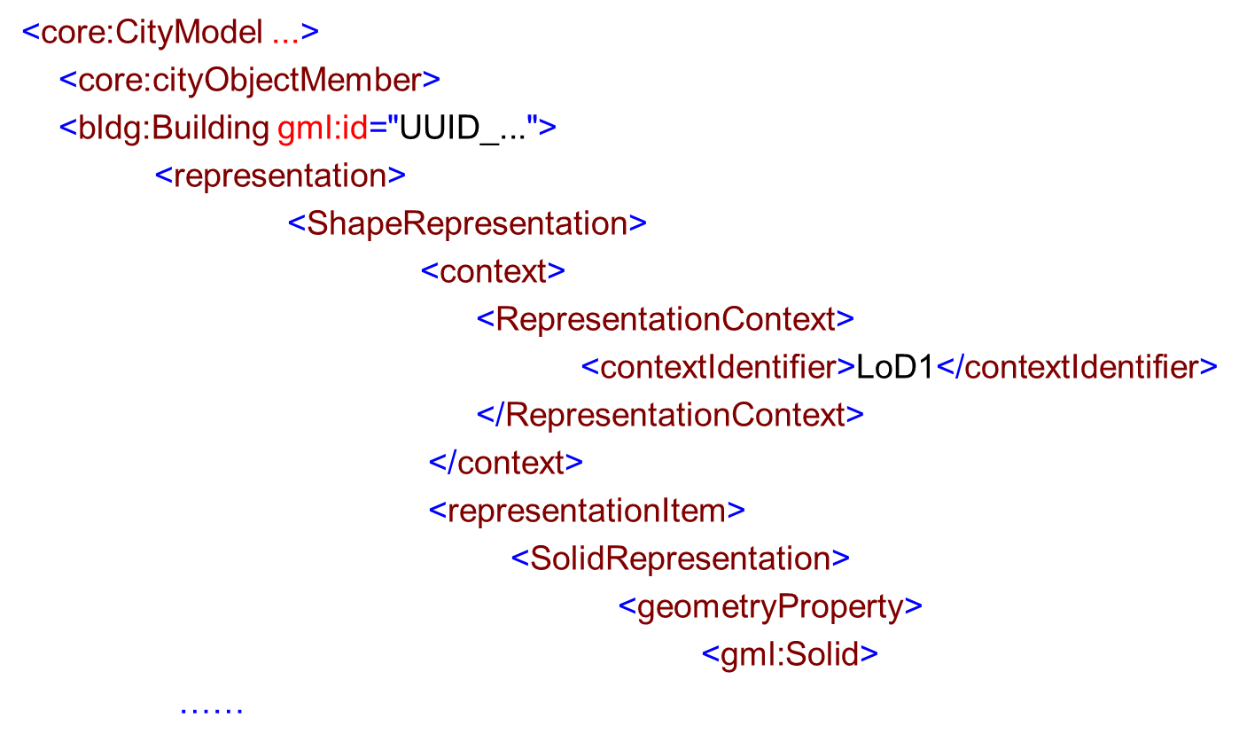
Example: Referencing a Profile by Name

Slide 10
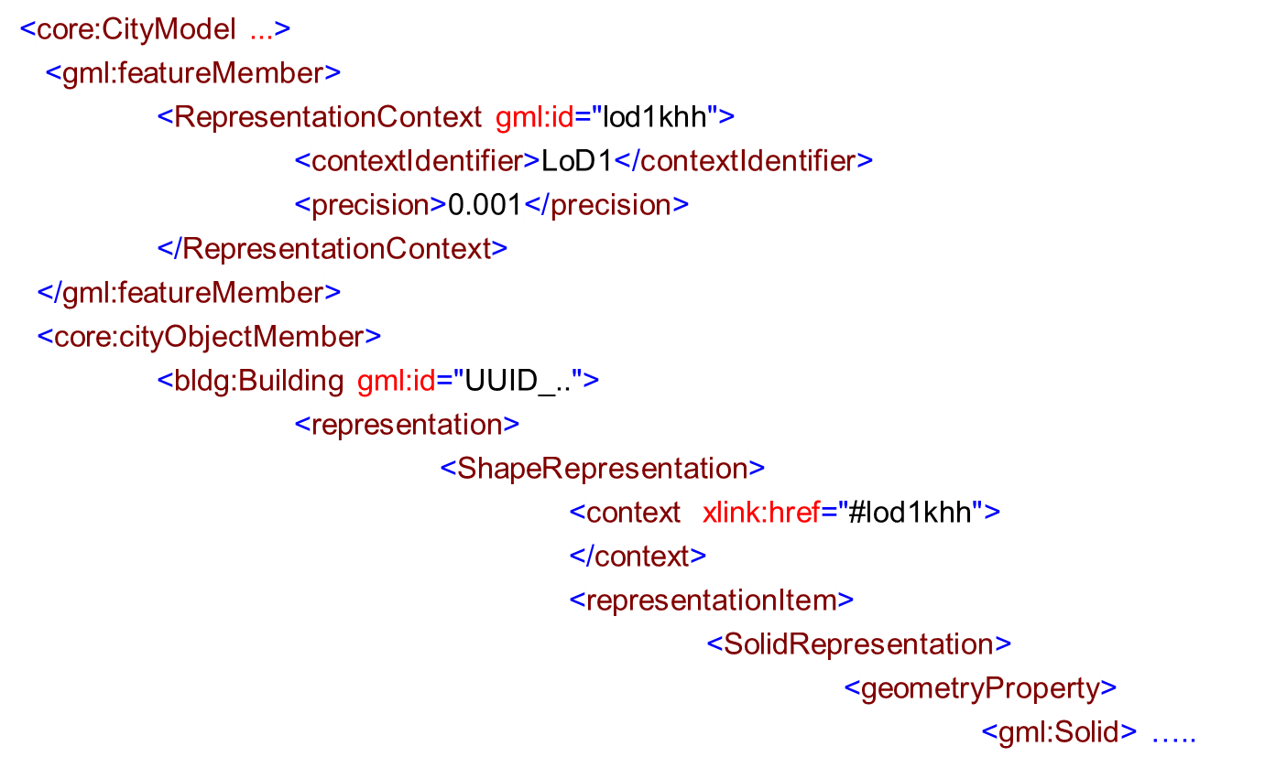
Example: Referencing a Profile by XLink

Slide 11
Profiles for embedding CityGML 2.0
 | CityGML2.0/ LoD0 | CityGML2.0/ LoD1 |  | CityGML2.0/ LoD2 |  | CityGML2.0/ LoD3 | CityGML2.0/ LoD4
Building | MSurfRep[0..1] //horizontal //surfaces, //footprint/roof //edge | MSurfRep[0..1] VolRep[0..1] //exclusive or //between both //Extrusion Solid |  | MCurveRep[0..1] MSurfRep[0..1] VolRep[0..1]
Wall Surface | / | / |  | MSurfRep[0..1]
Ceiling Surface | / | / |  | / |  | / | MSurfRep[0..1]
Room | / | / |  | / |  | / | MSurfRep[0..1] VolRep[0..1] //exclusive or //between both
Building Installation | / | / |  | GeomRep[0..1] ImplGeomRep[0..1]
Terrain Intersec. | / | MCurveRep[0..1]
Opening | / | / | / |  | MSurfRep [0..1] ImplGeomRep[0..1]

Slide 12
Official Profiles
defined and published in the CityGML specification
LoD4 has been replaced by LoD3 for indoor objects
Each Feature Type is represented in each LoD
  e.g., Rooms in LoD0 – LoD3
LoD0:
  projection of the corresponding LoD1 geometry onto a non-vertical surface
  Dimension is one lesser than dimension of the corresp. LoD1 geometry
Some Feature Types have been added:
  Storeys
  Terrain Intersection Curve (only a property in 2.0)

Slide 13
Official Profiles CityGML 3.0 I/IV
 | CityGML3.0/ LoD0 | CityGML3.0/ LoD1 | CityGML3.0/ LoD2 | CityGML3.0/ LoD3
Building/ BuildingPart | MSurfRep[0..1] SurfRep[0..1] PointRep[0..1] non-vertical (2.5D) surface, measured at footprint, roof edge level or any level | SolidRep[0..1] prismatic blocks model with vertical or horizontal boundary, unique height | SolidRep[0..1] MSurfRep[0..1] prismatic blocks model (with vertical boundary) with standard type, generalized roof shape, roof overhangs (opt), dormers/chimneys (opt) if shell is represented as solid, multi surfaces are restricted to roof overhangs | SolidRep[0..1] MSurfRep[0..1] MCurveRep[0..1] architectural models
Wall Surface | MCurveRep[0..1] CurvefRep[0..1] projection of wall surface onto footprint (of building or storey) | SurfRep[0..1] vertical | MSurfRep[0..1] SurfRep[0..1] | MSurfRep[0..1] SurfRep[0..1] architectural models
Roof Surface | MCurveRep[0..1] CurvefRep[0..1] 1D boundary of horizontal LoD1 roof surface | SurfRep[0..1] horizontal | MSurfRep[0..1] SurfRep[0..1] | MSurfRep[0..1] SurfRep[0..1] architectural models
Ground Surface | MCurveRep[0..1] CurvefRep[0..1] 1D boundary of horizontal LoD1 ground surface | SurfRep[0..1] horizontal | MSurfRep[0..1] SurfRep[0..1] | MSurfRep[0..1] SurfRep[0..1] architectural models

Slide 14
Official Profiles CityGML 3.0 II/IV
 | CityGML3.0/ LoD0 | CityGML3.0/ LoD1 | CityGML3.0/ LoD2 | CityGML3.0/ LoD3
Interior WallSurface | MCurveRep[0..1] CurvefRep[0..1] projection of wall surface onto footprint of storey | SurfRep[0..1] vertical | MSurfRep[0..1] ] SurfRep[ | MSurfRep[0..1] SurfRep[0..1] architectural models
Ceiling Surface | MCurveRep[0..1] CurvefRep[0..1] 1D boundary of horizontal LoD1 floor surface | SurfRep[0..1] horizontal | MSurfRep[0..1] SurfRep[0..1] | MSurfRep[0..1] SurfRep[0..1] architectural models
Floor Surface | MCurveRep[0..1] CurvefRep[0..1] 1D boundary of horizontal LoD1 floor surface | SurfRep[0..1] horizontal | MSurfRep[0..1] SurfRep[0 | MSurfRep[0..1] SurfRep[0..1] architectural models
(Int)Building Installation | MSurfRep[0..1] PointRep[0..1] MCurveRep[0..1] Non vertical | SolidRep[0..1] MCurveRep[0..1] ImplGeomRep[0..1] | GeometryRep[0..1] ImplGeomRep[0..1] generalized standard types | GeometryRep[0..1] ImplGeomRep[0..1] architectural models

Slide 15
Official Profiles CityGML 3.0 III/IV
 | CityGML3.0/ LoD0 | CityGML3.0/ LoD1 | CityGML3.0/ LoD2 | CityGML3.0/ LoD3
Opening | MCurveRep[0..1] CurvefRep[0..1] PointRep[0..1] projection of opening onto footprint (of building or storey) if represented as curve | SurfRep[0..1] Rectangle (vertical), cuts no hole / cut out in BoundarySurfaces or solid boundary | SurfRep[0..1] rectangle | MSurfRep[0..1] SurfRep[0..1] architectural models
Room | SurfRep[0..1] PointRep[0..1] footprint of room (floor level, ceiling level, …) | SolidRep[0..1] prismatic blocks model with vertical or horizontal boundary, unique height | SolidRep[0..1] MSurfRep[0..1] prismatic block with standardized, generalized ceiling shape and dormers (opt), | SolidRep[0..1] SurfRep[0..1] architectural models
Building Furniture | MSurfRep[0..1] PointRep[0..1] MCurveRep[0..1] non vertical | SolidRep[0..1] prismatic blocks model, unique height | GeomRep[0..1] ImplGeomRep[0..1] geometrical generalized geometry | GeomRep[0..1] ImplGeomRep[0..1] architectural models

Slide 16
Official Profiles CityGML 3.0 IV/IV
 | CityGML3.0/ LoD0 | CityGML3.0/ LoD1 | CityGML3.0/ LoD2 | CityGML3.0/ LoD3
Storey | MSurfRep[0..1] SurfaceRep[0..1] PointRep[0..1] footprint, non-vertical | SolidRep[0..1] prismatic blocks model with vertical/ horizontal boundary | SolidRep[0..1] MSurfRep[0..1] | MSurfRep[0..1] SurfRep[0..1] architectural models
TerrainInter-sectionCurve | MCurveRep[0..1] | MCurveRep[0..1] | MCurveRep[0..1] | MCurveRep[0..1]

Slide 17
Status of Work
General Principle: agreed on by WP 03 (Voting)
UML diagram and official profile: agreed on in principle, discussion of minor issues, voting next week
To Do:
  Definition of Constraints to exclude unreasonable geometry representations, e.g. a solid representation for a wall surface
  Transfer to other Modules (no task of WP 03):
    Derive profiles based on 2.0 geometry properties (bridge/tunnel: analogous to buildings, others: replace/delete LoD4)
    Modify UML diagram (delete geometry properties)

Slide 18
Answers to questions of SWG chairs
Is the WP active? Yes
If active, please describe the nature and scope of the work and expected results. See presentation
If active, what is the current status? Almost Finished
If active but directly dependent on another WP, please describe the dependency and expected outcome. WP 03 does not depend on other WPs
If active but requires SWG decision(s), please describe the issues. No
Is it likely that the WP results will break existing CityGML 2.0 instance documents? Yes, definitively

Slide 19
Answers to questions of SWG chairs
Could your results be adopted incrementally by the SWG? No
Could your results be implemented as an ADE. Yes, provisionally. Add new geometry properties to _CityObject by using the hooking mechanism, prohibit use of current geometry properties
Are there resources that would help? Concept has to be applied to other modules than building module
Other significant issues. No.

